Slide 1
CS 631 Final Presentation
The Maze Project
May 10, 2021

Slide 2
Project Team
Derek Osik
George Varghese

Slide 3
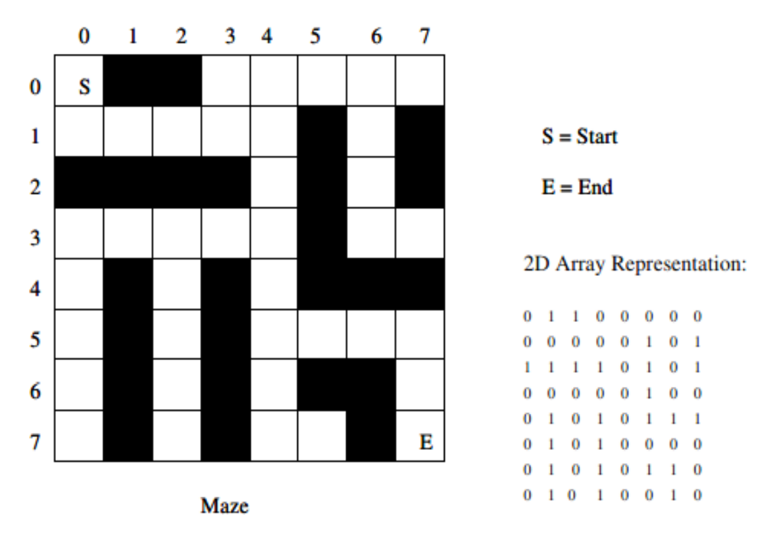
Maze Challenge
Propose an algorithm that traverses a predefined maze and prints out a path from the Starting Point (S) to Exit (E)
Use Stack to track Solutions Path

Slide 4
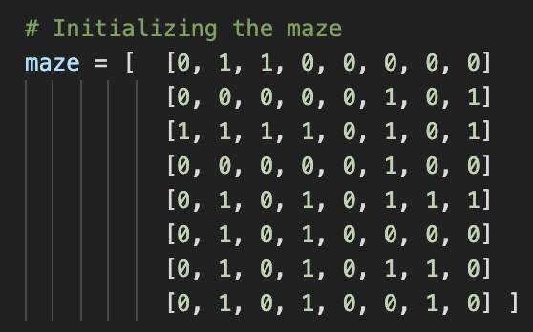
Initialization Inputs
Starting Position, Ending Position
Maze size for an 8 by 8 maze, N = 8
Maze Matrix is represented as arrays of 1’s and 0’s, where 0’s are valid positions and 1’s are invalid, Out-of-Matrix is invalid)

Slide 5
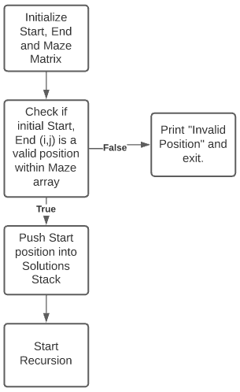
Algorithm (Initial Steps)
Notes:
Make sure to call out valid means in the maze and a valid position (0)

Slide 6
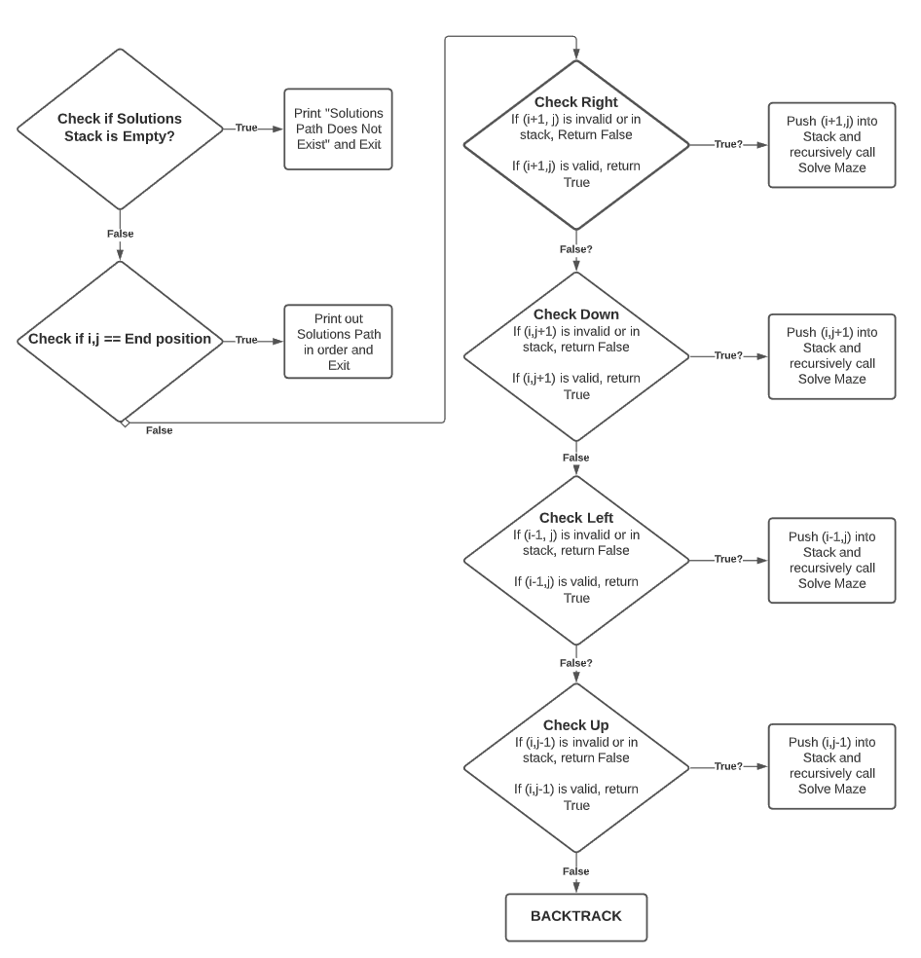
i=2
j =1
Solve Maze Function
Solutions Stack = 0,0 | 0,1 | 1,1 | 2,1
Recursion Flowchart

Slide 7
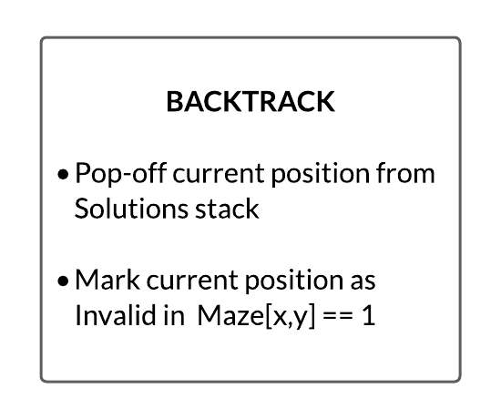
Illustration of Backtracking
Solutions Stack = 4,5 | 4,6 | 4,7 | 5,7

Slide 8
Illustration of Backtracking - Part 2

Slide 9
Solution Output
Solution Path Stack:
(0,0),
(0,1),
(1,1),
(2,1),
(3,1),
(4,1),
(4,2),
(4,3),
(4,4),
(4,5),
(5,5),
(6,5),
(7,5),
(7,6),
(7,7)
OR
No Solution:
“Solution path does not exist”

Slide 10
Time Complexity of Algorithm
Maze Matrix Size = N² [in our case, N=8]
Upper bound for i and j == (N-1)
Time Complexity: T(N) = O(4^(M)) = O(4^(2*N))
At every position, there are four possible directions
M = 2*N = max depth of a leaf node in the search tree of the different paths
(or max depth of Solutions stack)
Space Complexity :
SPACE(N) = O(4*M)

Slide 11
Questions?

Slide 12
Solutions Algorithm
Initialize Start position, End position, and Maze Matrix
Check if Start & End are valid positions within the Maze Matrix (0=valid, 1=invalid, Out-of-Matrix = invalid). If False, print “Invalid Position” and return. If True, goto Next
Push start position into an empty Solutions Path Stack
Initialize a recursive function that will find the maze solution:
Check if Solutions stack is empty. If True, print out “Solution path does not exist”. If False, goto Next.
Check if current position is the End position. If True, print Solution Path Stack and return. If False, then goto Next.
Check for next available position (Right, Down, Left, Up):
Check Right direction (i+1,j): If (i+1,j) is invalid or already in the stack, return False. If (i+1,j) is valid, return True and push ‘(i+1,j)’ into stack and exit. If False, then goto Next.
Check Down direction (i,j+1): If (i,j+1) is invalid or already in the stack, return False. If (i,j+1) is valid, return True and push ‘(i,j+1)’ into stack and exit. If False, then goto Next.
Check Left direction (i-1,j): If (i-1,j) is invalid or already in the stack, return False. If (i-1,j) is valid, return True and push ‘(i-1,j)’ into stack and exit. If False, then goto Next.
Check Up direction (i,j-1): If (i,j-1) is invalid or already in the stack, return False. If (i,j-1) is valid, return True and push ‘(i,j-1)’ into stack and exit. If False, then goto BACKTRACK.
BACKTRACK: pop-off current position from Solutions stack, mark this position as invalid in Maze Matrix, and return to beginning of recursive function

Slide 13

OLD - Illustration of ‘Next Available Position’ Recursion (Right, Down, Left, Up)
Check Right direction (i+1,j): If (i+1,j) is invalid or already in the stack, return False. If (i+1,j) is valid, return True and push ‘(i+1,j)’ into stack and exit. If False, then goto Next.
Check Down direction (i,j+1): If (i,j+1) is invalid or already in the stack, return False. If (i,j+1) is valid, return True and push ‘(i,j+1)’ into stack and exit. If False, then goto Next.
Check Left direction (i-1,j): If (i-1,j) is invalid or already in the stack, return False. If (i-1,j) is valid, return True and push ‘(i-1,j)’ into stack and exit. If False, then goto Next.
Check Up direction (i,j-1): If (i,j-1) is invalid or already in the stack, return False. If (i,j-1) is valid, return True and push ‘(i,j-1)’ into stack and exit. If False, then goto BACKTRACK.
BACKTRACK: pop-off current position from Solutions stack, mark this position as invalid in Maze Matrix, and return to beginning of recursive function

